Slide 1

X Education data analysis for improving Revenue

Slide 2
Problem Statement & Objectivesoblem Statement & Objectives
The Business Problem : X Education has a lead conversion rate of approximately 30%. They acquire roughly 100 leads daily but struggle to identify which ones are truly potential "Hot Leads."
Objective : To build a Logistic Regression model that assigns a Lead Score (0- 100) to each potential customer.
Goal : Increase conversion efficiency by allowing the sales team to focus their communication on high-probability leads rather than calling every single person.

Slide 3
Analysis ApproachStatement & Objectives
Data Cleaning : Handled missing values and categorized "Select" as a null value since it indicates a lead did not choose an option from the dropdown menu.
Exploratory Data Analysis (EDA): Identified key variables influencing conversion, such as Lead Source, Total Time Spent on Website, and Last Activity.
Model Building : Performed Feature Engineering and Encoding for categorical variables.
                Used Recursive Feature Elimination (RFE) to select the most relevant features.
                Built a Logistic Regression model using statsmodels for detailed statistical analysis.
Evaluation : Used metrics like Accuracy, Sensitivity (Recall), and Specificity to validate performance.

Slide 4
Model Performance Results& Objectives
Overall Accuracy : The final model achieved an accuracy of approximately 78-79%
Performance Metrics:
  Recall (Sensitivity) : 0.80 (80%). The model successfully identifies 80% of actual conversions.
  Precision : 0.70 (70%). When the model identifies a lead as "hot," it is correct 70% of the time.
Optimal Cut-off : A threshold of approximately 0.3 to 0.4 was found to be optimal for balancing lead capture (Recall) and efficiency (Precision).

Slide 5
Results in Business Terms& Objectives
Lead Prioritization : Leads are now scored on a 0-100 scale. Leads with a score above 80 are "Hot Leads" and should be contacted immediately.
Resource Efficiency : By focusing on the top 40% of scored leads, the sales team can potentially capture 80% of all conversions, significantly reducing wasted call time.
Improved Conversion : Moving from a "blanket calling" approach to a "data-driven" approach is expected to push the conversion rate from 30% toward a higher target efficiency.

Slide 6
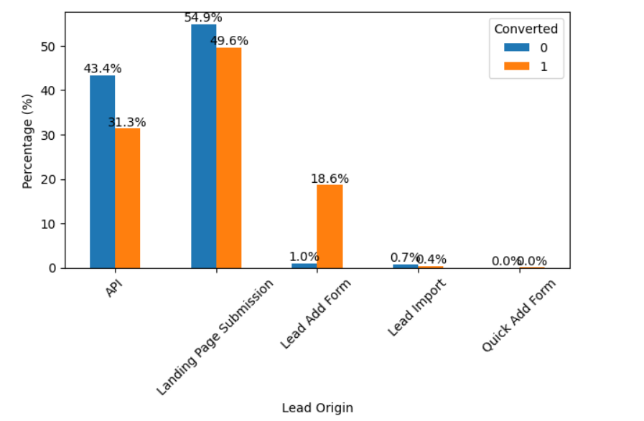
Key Drivers of Conversion (Visualizing Results)& Objectives

Slide 7
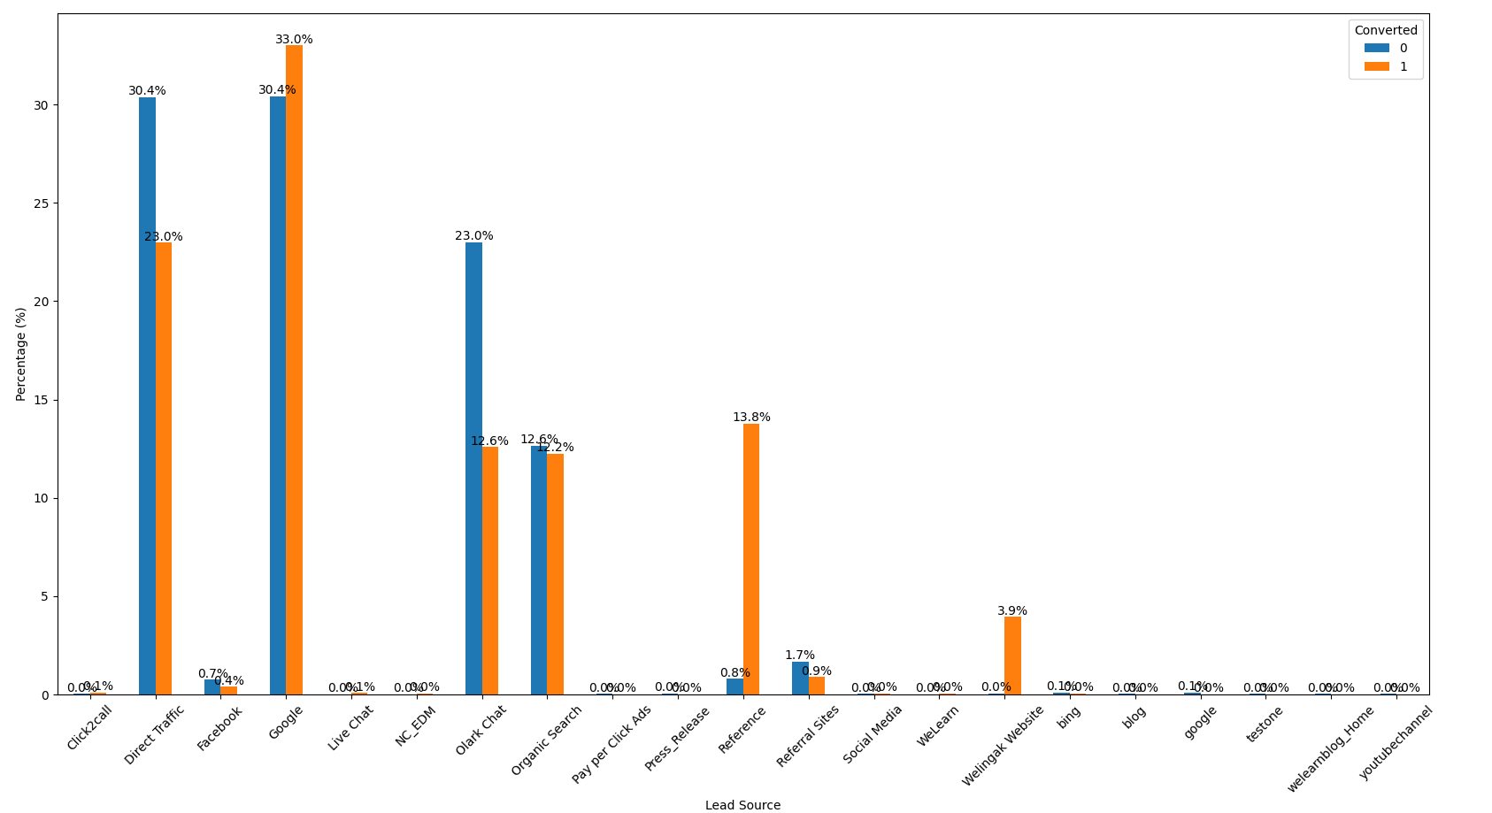
Key Drivers of Conversion (Visualizing Results)& Objectives

Slide 8
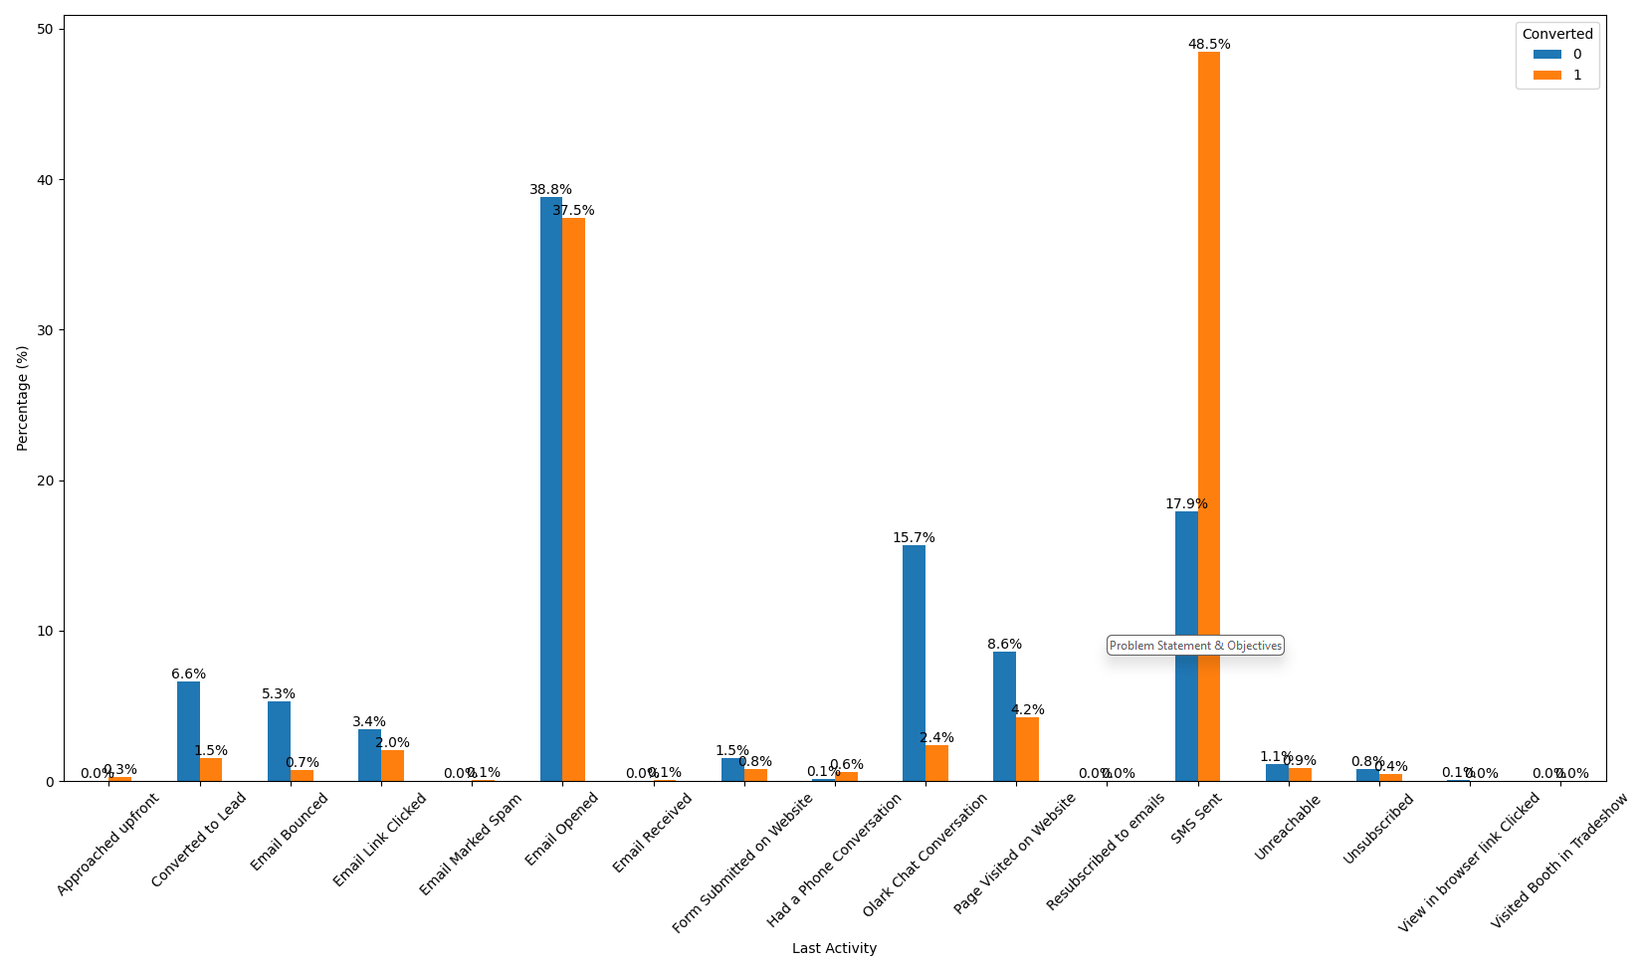
Key Drivers of Conversion (Visualizing Results)& Objectives

Slide 9
Recommendations & Learnings& Objectives
Recommendation 1 : Implement automated SMS follow-ups, as "SMS Sent" is a high- impact feature for conversion.
Recommendation 2 : Increase focus on referrals and the Welingak lead source, as they provide high-quality leads.
Recommendation 3 : Focus more on improving their website, emails, Booth-experience in tradeshow and Olark Chat to help potential customers to get what do they seek as fast as possible.
Learning : Logistic Regression provided a clear "Lead Score" that is easily interpretable for business managers, unlike "black box" models.

